Slide 1
Leviticus
Lessons in Salvation

Slide 2
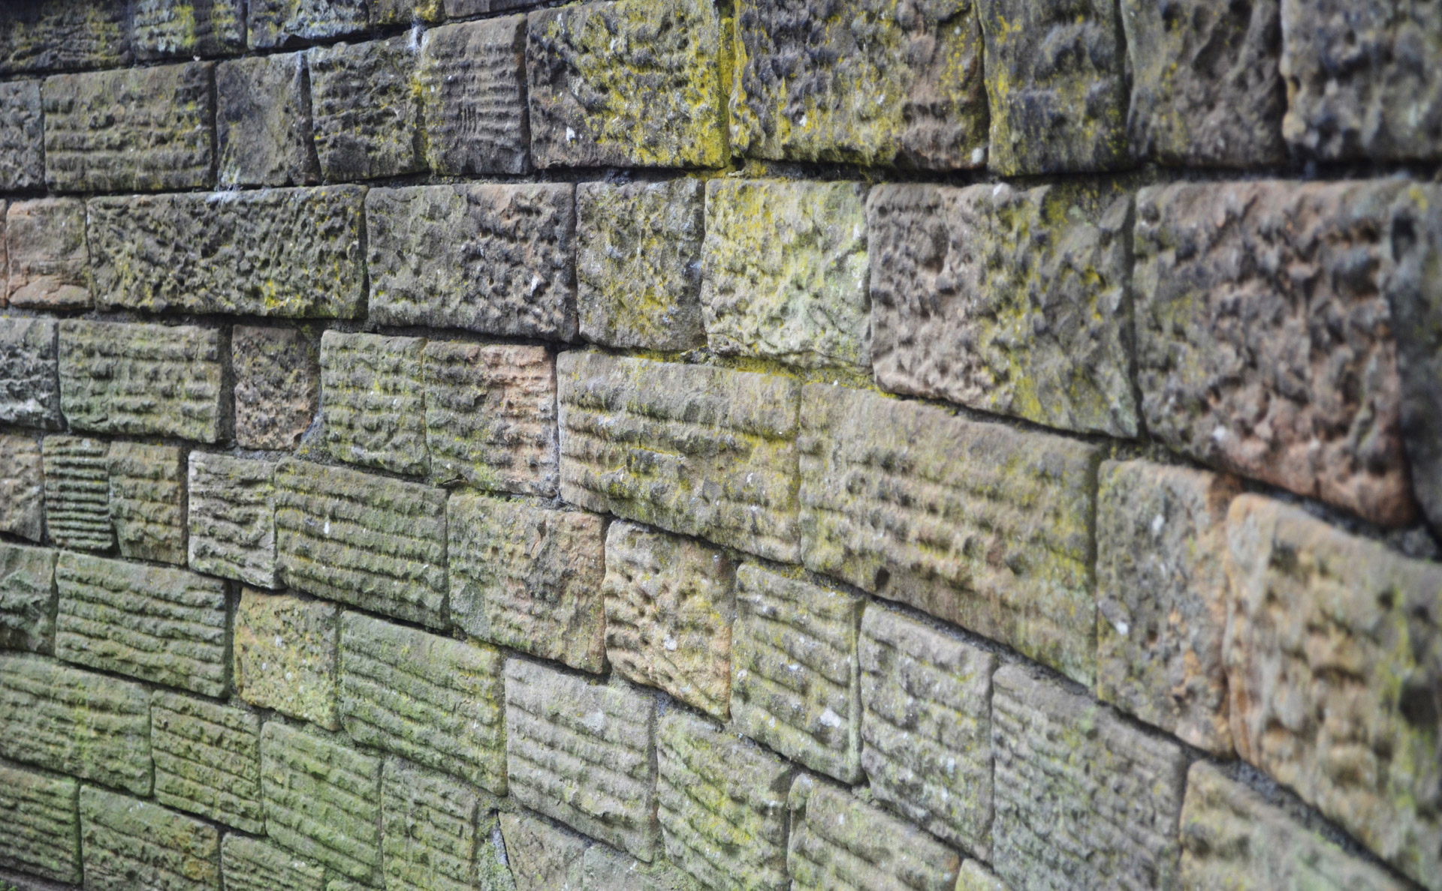
Leviticus An Old Testament Impediment
Question; What is all the bewilderment about?

Slide 3
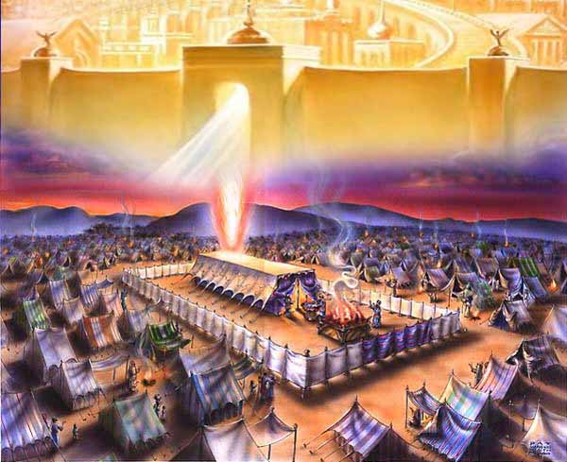
Lessons in pictures
This Photo by Unknown author is licensed under CC BY-SA-NC.

Slide 4
The Building Vs the Work
Exodus ends with the dedication of the Tabernacle, Leviticus deals with the service of the Sanctuary

Slide 5
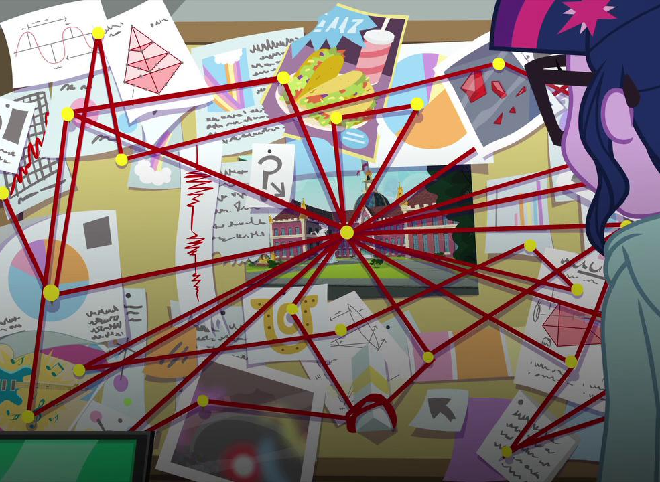
So Many and Varied sacrifices...
From National Sin to contaminated pots!
This Photo by Unknown author is licensed under CC BY-SA.

Slide 6
Hard to see the forest for the trees...
Then verily the first covenant had also ordinances of divine service, and a worldly sanctuary. For there was a tabernacle made; the first, wherein was the candlestick, and the table, and the shewbread; which is called the sanctuary.

Slide 7
And after the second veil, the tabernacle which is called the Holiest of all;
Which had the golden censer, and the ark of the covenant overlaid round about with gold, wherein was the golden pot that had manna, and Aaron's rod that budded, and the tables of the covenant;

Slide 8
And over it the cherubims of glory shadowing the mercyseat; of which we cannot now speak particularly. (And All The Congregation Said "Amen" ;o)
Now when these things were thus ordained, the priests went always into the first tabernacle, accomplishing the service of God.

Slide 9
But into the second went the high priest alone once every year, not without blood, which he offered for himself, and for the errors of the people:
The Holy Ghost this signifying, that the way into the holiest of all was not yet made manifest, while as the first tabernacle was yet standing:

Slide 10
Which was a figure for the time then present, in which were offered both gifts and sacrifices, that could not make him that did the service perfect, as pertaining to the conscience; Hebrews 9:1-9

Slide 11
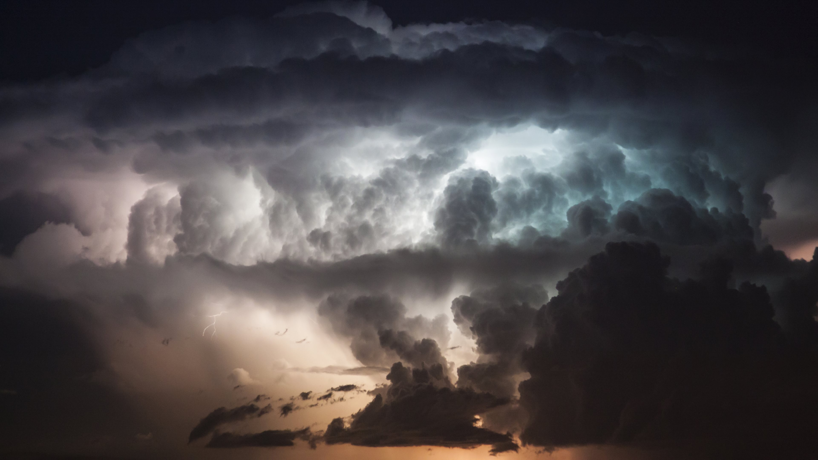
As you read Leviticus, what were your feelings regarding the service of God?
Were you somewhat disheartened?
This Photo by Unknown author is licensed under CC BY-SA.

Slide 12
A Critical, Fault Finding God?

Slide 13
Or Is There a Different Lesson...
The LORD came from Sinai, and rose up from Seir unto them; he shined forth from mount Paran, and he came with ten thousands of saints: from his right hand went a fiery law for them.
Yea, he loved the people!
Deut. 33:2,3

Slide 14
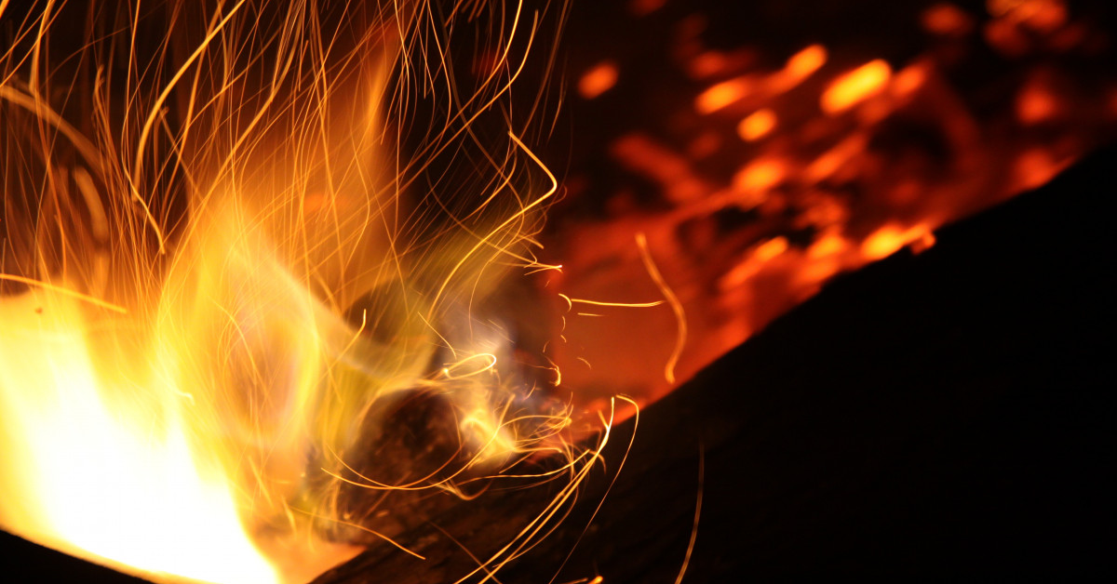
Sin... It's no light thing or Joke
A sacrifice for sin was
required
for every sin!

Slide 15
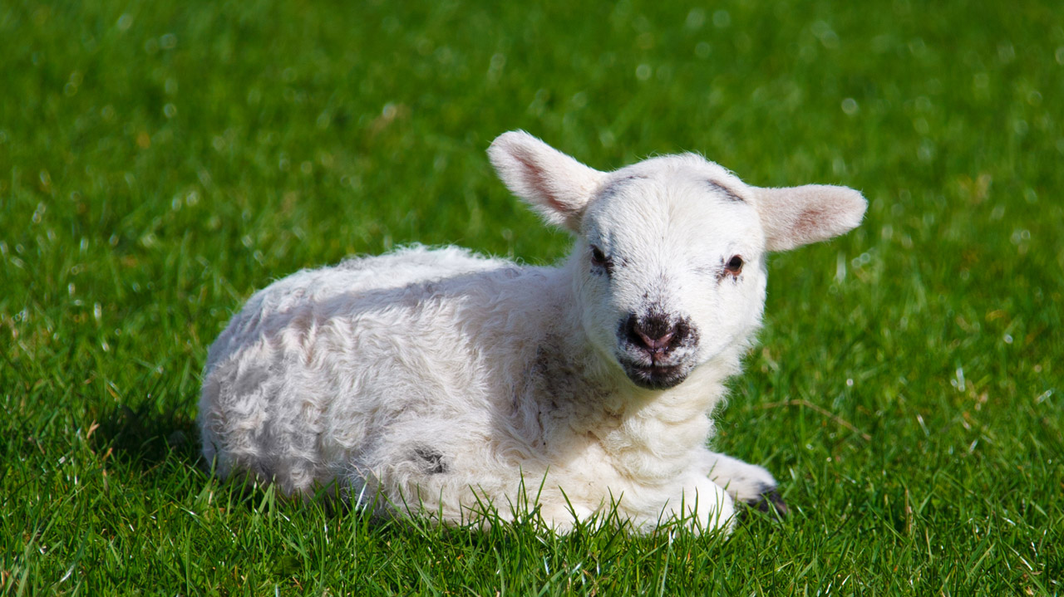
What Was The End Goal of All These Sacrifices and Services...
ATONEMENT

Slide 16
The Day of Atonment Leviticus 23:26-31
And the LORD spake unto Moses, saying, Also on the tenth day of this seventh month there shall be a day of atonement: it shall be an holy convocation unto you; and ye shall afflict your souls, and offer an offering made by fire unto the LORD.

Slide 17
Leviticus 23:26-31
And ye shall do no work in that same day: for it is a day of atonement, to make an atonement for you before the LORD your God. For whatsoever soul it be that shall not be afflicted in that same day, he shall be cut off from among his people.

Slide 18
Leviticus 23:26-31
And whatsoever soul it be that doeth any work in that same day, the same soul will I destroy from among his people. Ye shall do no manner of work:

Slide 19
A Personal Application
Now all these things happened unto them for ensamples: and they are written for our admonition, upon whom the ends of the world are come.
1 Cor 10:11

Slide 20
Laodicea... AKA Us...
The Church of the Antitypical day of atonement...

Slide 21
Lackadaisical Laodicea
Question; If God was so particular regarding sin and the need for atonement in the symbolic service, do you think that need for atonement and purity would be greater or less when it comes to reality?

Slide 22
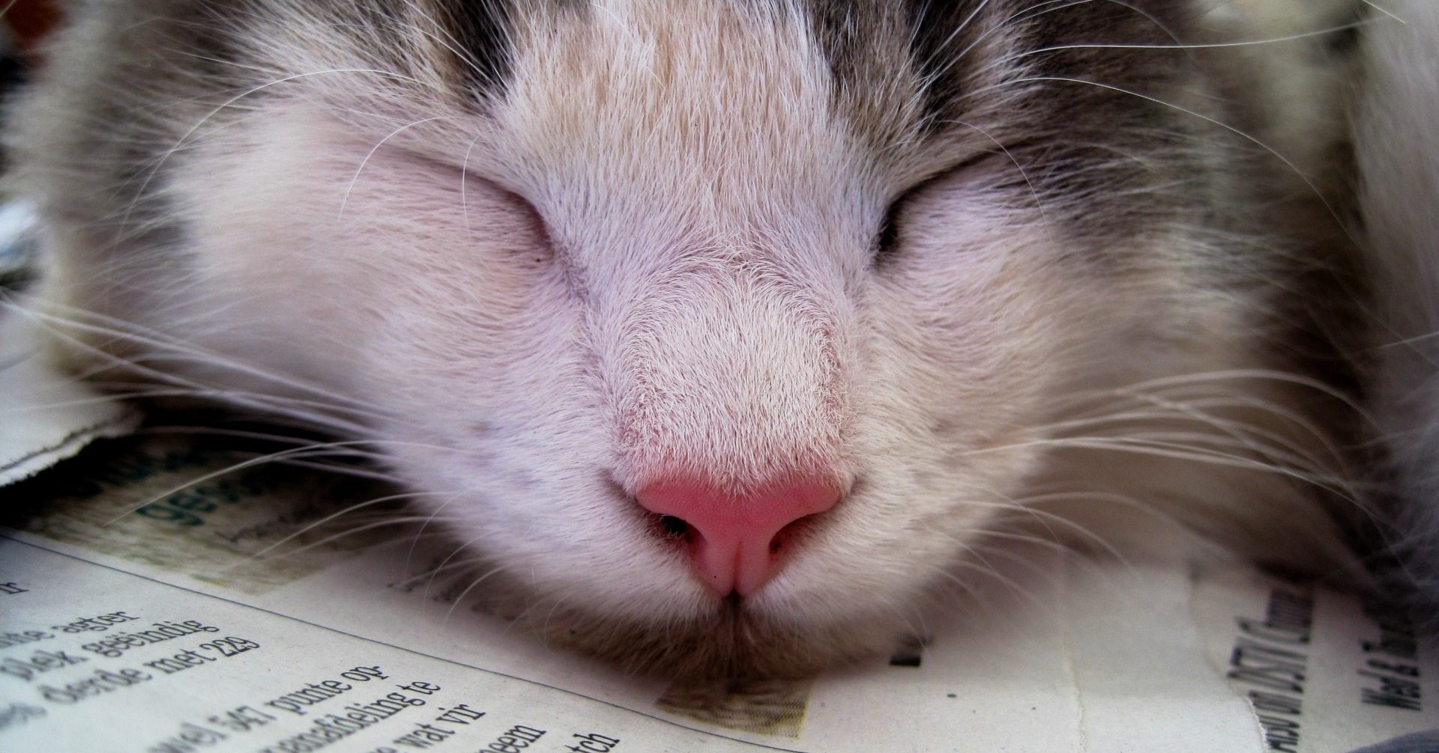
Indifference
Laodicea is an indifferent church. We seem to have no (or very little) interest in the antitypical day of atonement. We seem to think we are good to go!

Slide 23
Is Neglect Safe?
Therefore we ought to give the more earnest heed to the things which we have heard, lest at any time we should let them slip. For if the word spoken by angels was stedfast, and every transgression and disobedience received a just recompence of reward; How shall we escape, if we neglect so great salvation Heb. 2:1-3

Slide 24
Cheap Grace Can Wear Many Hats!
The last church thinks it's rich and needs nothing, but it is poor miserable blind and naked...

Slide 25
We Have lost Sight of Our great Need!
The whole world is covered by God's Grace, as is the church, but both are not yet one with God!

Slide 26
We Need A High Priest... We Need Christ's Work In Our behalf...
Question: Why?

Slide 27
There's No Fooling God Hebrews 4:12-14
For the word of God is quick, and powerful, and sharper than any two-edged sword, piercing even to the dividing asunder of soul and spirit, and of the joints and marrow, and is a discerner of the thoughts and intents of the heart. Neither is there any creature that is not manifest in his sight: but all things are naked and opened unto the eyes of him with whom we have to do.

Slide 28
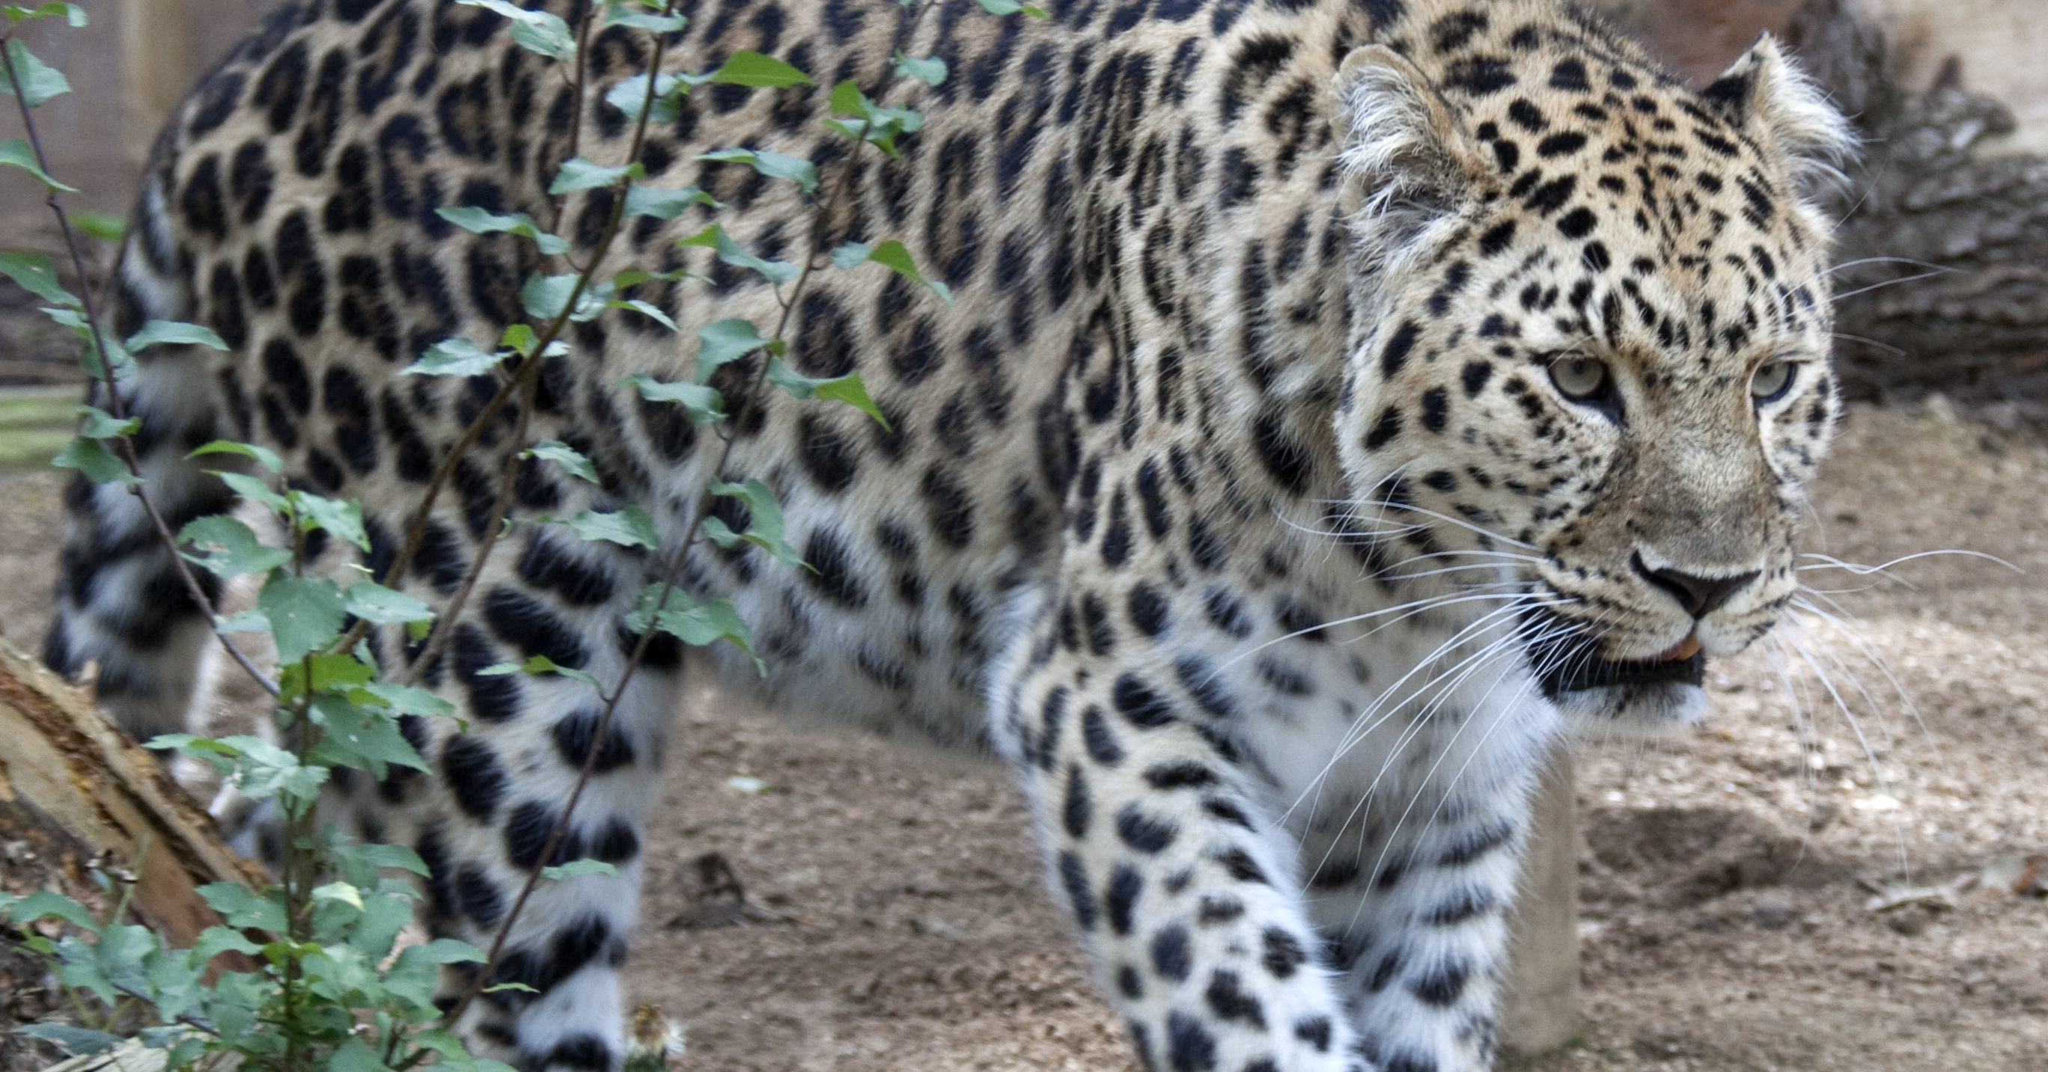
You and I are not pure and spotless... We are not actually one with God in Reality...
This Photo by Unknown author is licensed under CC BY-SA.

Slide 29
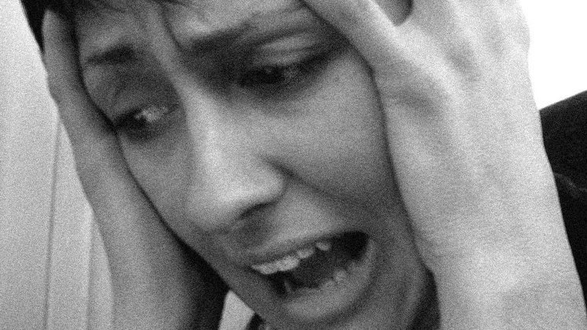
We Need to wake Up and Pay attention!
This Photo by Unknown author is licensed under CC BY.

Slide 30
The condition of the unbelieving Jews illustrates the condition of the careless and unbelieving among professed Christians, who are willingly ignorant of the work of our merciful High Priest. In the typical service, when the high priest entered the most holy place, all Israel were required to gather about the sanctuary and in the most solemn manner humble their souls before God, that they might receive the pardon of their sins and not be cut off from the congregation. How much more essential in this antitypical Day of Atonement that we understand the work of our High Priest and know what duties are required of us. GC 430.3

Slide 31
We Have a Helper...
Seeing then that we have a great high priest, that is passed into the heavens, Jesus the Son of God, let us hold fast our profession. For we have not an high priest which cannot be touched with the feeling of our infirmities; but was in all points tempted like as we are, yet without sin. Let us therefore come boldly unto the throne of grace, that we may obtain mercy, and find grace to help in time of need. Heb 4:14-16

Slide 32
Coming and Afflicting
We must come to Christ and trust in His work for us, we must admit our utter helplessness and utter inability by any work of ours to realize atonement with God.

Slide 33
Faith in What?
Question, What is Christ doing in heaven now which will result in our perfect oneness with God when He is finished? It is an important question. Not one to be taken lightly in light of where we stand in time!

Slide 34
The Mediator of a New Covenant (Will & Testament)
But Christ came as High Priest of the good things to come, with the greater and more perfect tabernacle not made with hands, that is, not of this creation. Not with the blood of goats and calves, but with His own blood He entered the Most Holy Place once for all, having obtained eternal redemption.

Slide 35
The Mediator of a New Covenant (Will & Testament)
For if the blood of bulls and goats and the ashes of a heifer, sprinkling the unclean, sanctifies for the purifying of the flesh, how much more shall the blood of Christ, who through the eternal Spirit offered Himself without spot to God, cleanse your conscience from dead works to serve the living God? And for this reason He is the Mediator of the new covenant,... that those who are called may receive the promise of the eternal inheritance...

Slide 36
We Stand on Jordans Banks As Israel Did...
The Implementation of the new covenant (Will & Testament) is what Christ is doing in heaven, We must have an understanding of Christ's work which will be as"... an anchor of the soul, both sure and stedfast, and which entereth into that within the veil; Whither the forerunner is for us entered, even Jesus

