Slide 1
Focus

Slide 2
There is a great deal going on in our world...

Slide 3
Conflict, Wars and rumors of war...

Slide 4
Massive protests and unrest
This Photo by Unknown author is licensed under CC BY-SA-NC.

Slide 5
It is hard to know what to focus on!

Slide 6
Worldly VS spiritual causes
Some see these conflicts from mostly a political or secular point of view, and seem unable to see further than that...
This Photo by Unknown author is licensed under CC BY-NC-ND.

Slide 7
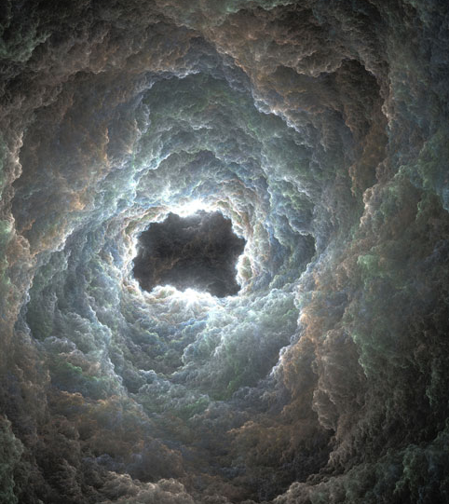
Our paradigm
...And there was war in heaven: Michael and his angels fought against the dragon; and the dragon fought and his angels,...

Slide 8
And prevailed not; neither was their place found any more in heaven. And the great dragon was cast out, that old serpent, called the Devil, and Satan, which deceiveth the whole world: he was cast out into the earth, and his angels were cast out with him.
Rev 12:7-9
This Photo by Unknown author is licensed under CC BY-SA.

Slide 9
We should view all the happenings in this world through this Lense

Slide 10
The real cause of the conflict in the middle east
This Photo by Unknown author is licensed under CC BY-NC-ND.

Slide 11
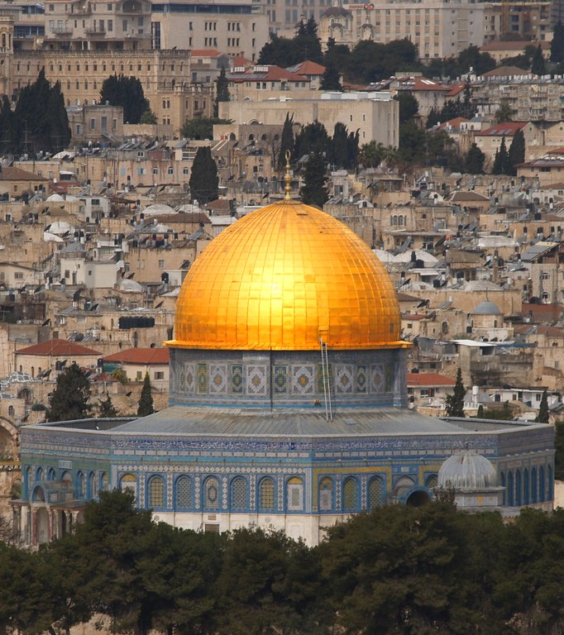
Faulty interpretation of scripture at the heart of this conflict!
This Photo by Unknown author is licensed under CC BY.

Slide 12
Three abrihamic "faiths"
This Photo by Unknown author is licensed under CC BY-SA.

Slide 13
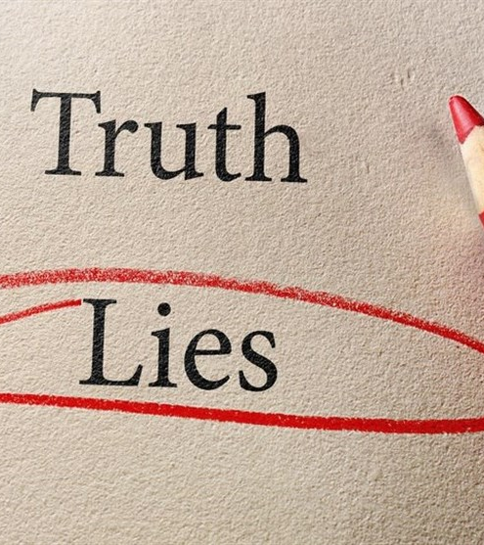
Three deceived ideas regarding prophecy
This Photo by Unknown author is licensed under CC BY.

Slide 14
The author of these deceptions is the devil who plays scrabble with prophecy

Slide 15
For the Christians he uses...
...Now we beseech you, brethren, by the coming of our Lord Jesus Christ, and by our gathering together unto him, That ye be not soon shaken in mind, or be troubled, neither by spirit, nor by word, nor by letter as from us, as that the day of Christ is at hand...

Slide 16
Let no man deceive you by any means: for that day shall not come, except there come a falling away first, and that man of sin be revealed, the son of perdition; 4Who opposeth and exalteth himself above all that is called God, or that is worshipped; so that he as God sitteth in the temple of God, shewing himself that he is God.
2Thess 2:1-4

Slide 17
So there must be a temple built
This Photo by Unknown author is licensed under CC BY-SA-NC.

Slide 18
For the jews he uses their rejection of Jesus as the true messiah; which drives them to try to re-establish the temple & its sacrificial services destroyed by the romans

Slide 19
So there must be a temple built
This Photo by Unknown author is licensed under CC BY-SA-NC.

Slide 20
For the Muslims;
he uses the misapplication of promise/prophecy... God's promise of salvation through the son of promise they attribute to Ishmail not Isacc...

Slide 21
...There must not be a temple built!
This Photo by Unknown author is licensed under CC BY-SA-NC.

Slide 22
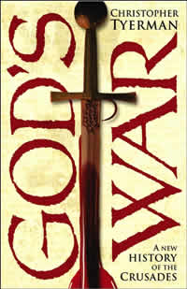
And so we have had a terrible conflict authored by the father of lies. Each religion convinced they are right!
This Photo by Unknown author is licensed under CC BY-SA.

Slide 23
The truth
This Photo by Unknown author is licensed under CC BY-SA.

Slide 24
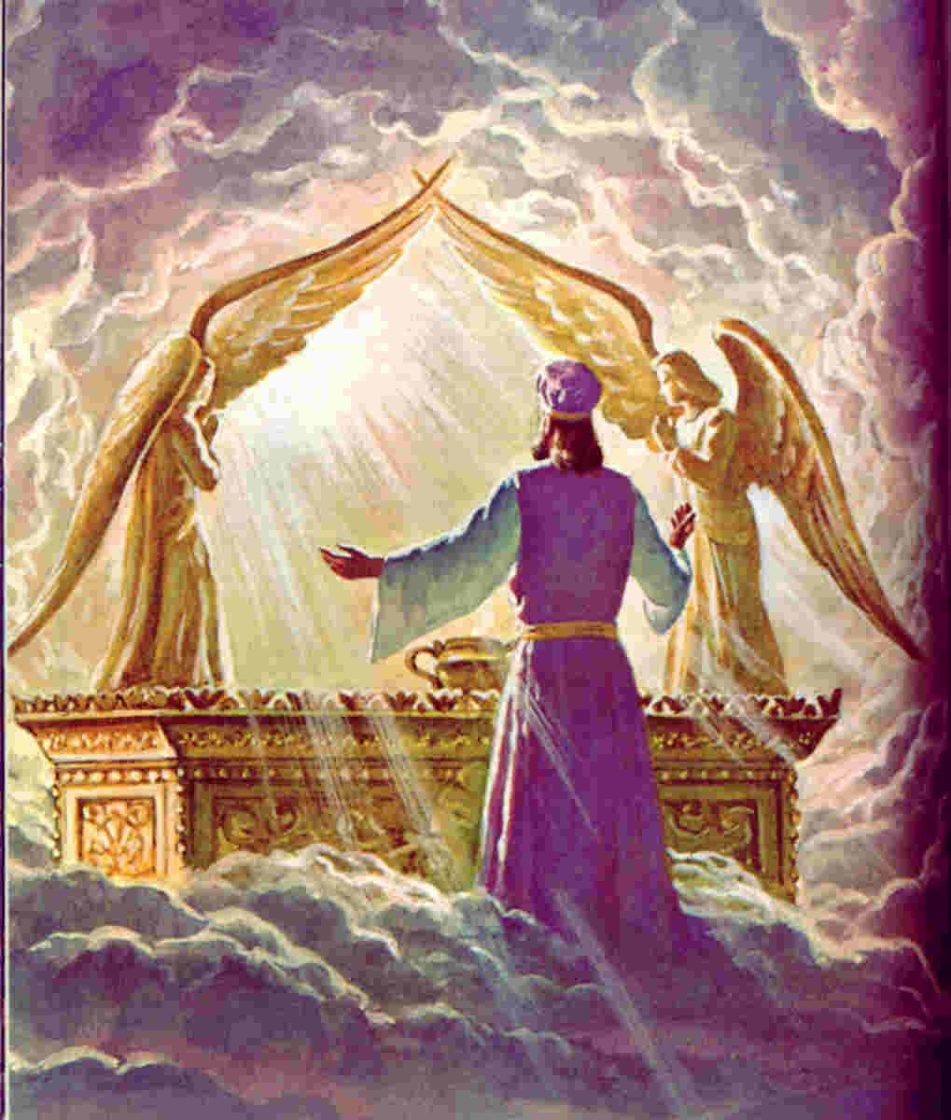
The Sanctuary
At no time are we to lose sight of the important work being done in our behalf in the sanctuary in heaven. (CIHS 26.1)
This Photo by Unknown author is licensed under CC BY-SA-NC.

Slide 25
Now of the things which we have spoken this is the sum: We have such an high priest, who is set on the right hand of the throne of the Majesty in the heavens; A minister of the sanctuary, and of the true tabernacle, which the Lord pitched, and not man.

Slide 26
...For every high priest is ordained to offer gifts and sacrifices: wherefore it is of necessity that this man have somewhat also to offer. For if he were on earth, he should not be a priest, seeing that there are priests that offer gifts according to the law: Who serve unto the example and shadow of heavenly things,...

Slide 27
...as Moses was admonished of God when he was about to make the tabernacle: for, See, saith he, that thou make all things according to the pattern shewed to thee in the mount
Heb 8:1-5

Slide 28
Question #1
Do Seventh-Day Adventists know the truth about the Sanctuary, not on this earth, but in Heaven?

Slide 29
Answer...
Technically yes...

Slide 30
Question #2
Do Seventh-Day Adventists know the truth about the Sanctuary, not on this earth, but in Heaven?

Slide 31
answer...
On a practical level... in practice and every day spiritual life that answer is in some doubt...

Slide 32
hackneyed expressions

Slide 33
Definition:
A hackneyed phrase or idea has been said or used so often that it has become boring and has no meaning
Cambridge Dict.

Slide 34
Pleading & Intercession...

Slide 35
Disruptive text...
...At that day ye shall ask in my name: and I say not unto you, that I will pray the Father for you: For the Father himself loveth you...
John 16:26,27

Slide 36
Advocate
This Photo by Unknown author is licensed under CC BY-SA.

Slide 37
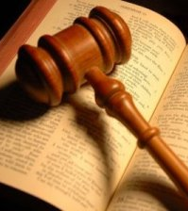
Does Jesus need to talk himself into our salvation?
For the Father judgeth no man, but hath committed all judgment unto the Son:
John 5:22
This Photo by Unknown author is licensed under CC BY-NC-ND.

Slide 38
Individual duty and responsibility regarding the sanctuary doctrine...
The subject of the sanctuary and the investigative judgment should be clearly understood by the people of God. All need a knowledge for themselves of the position and work of their great High Priest...

Slide 39
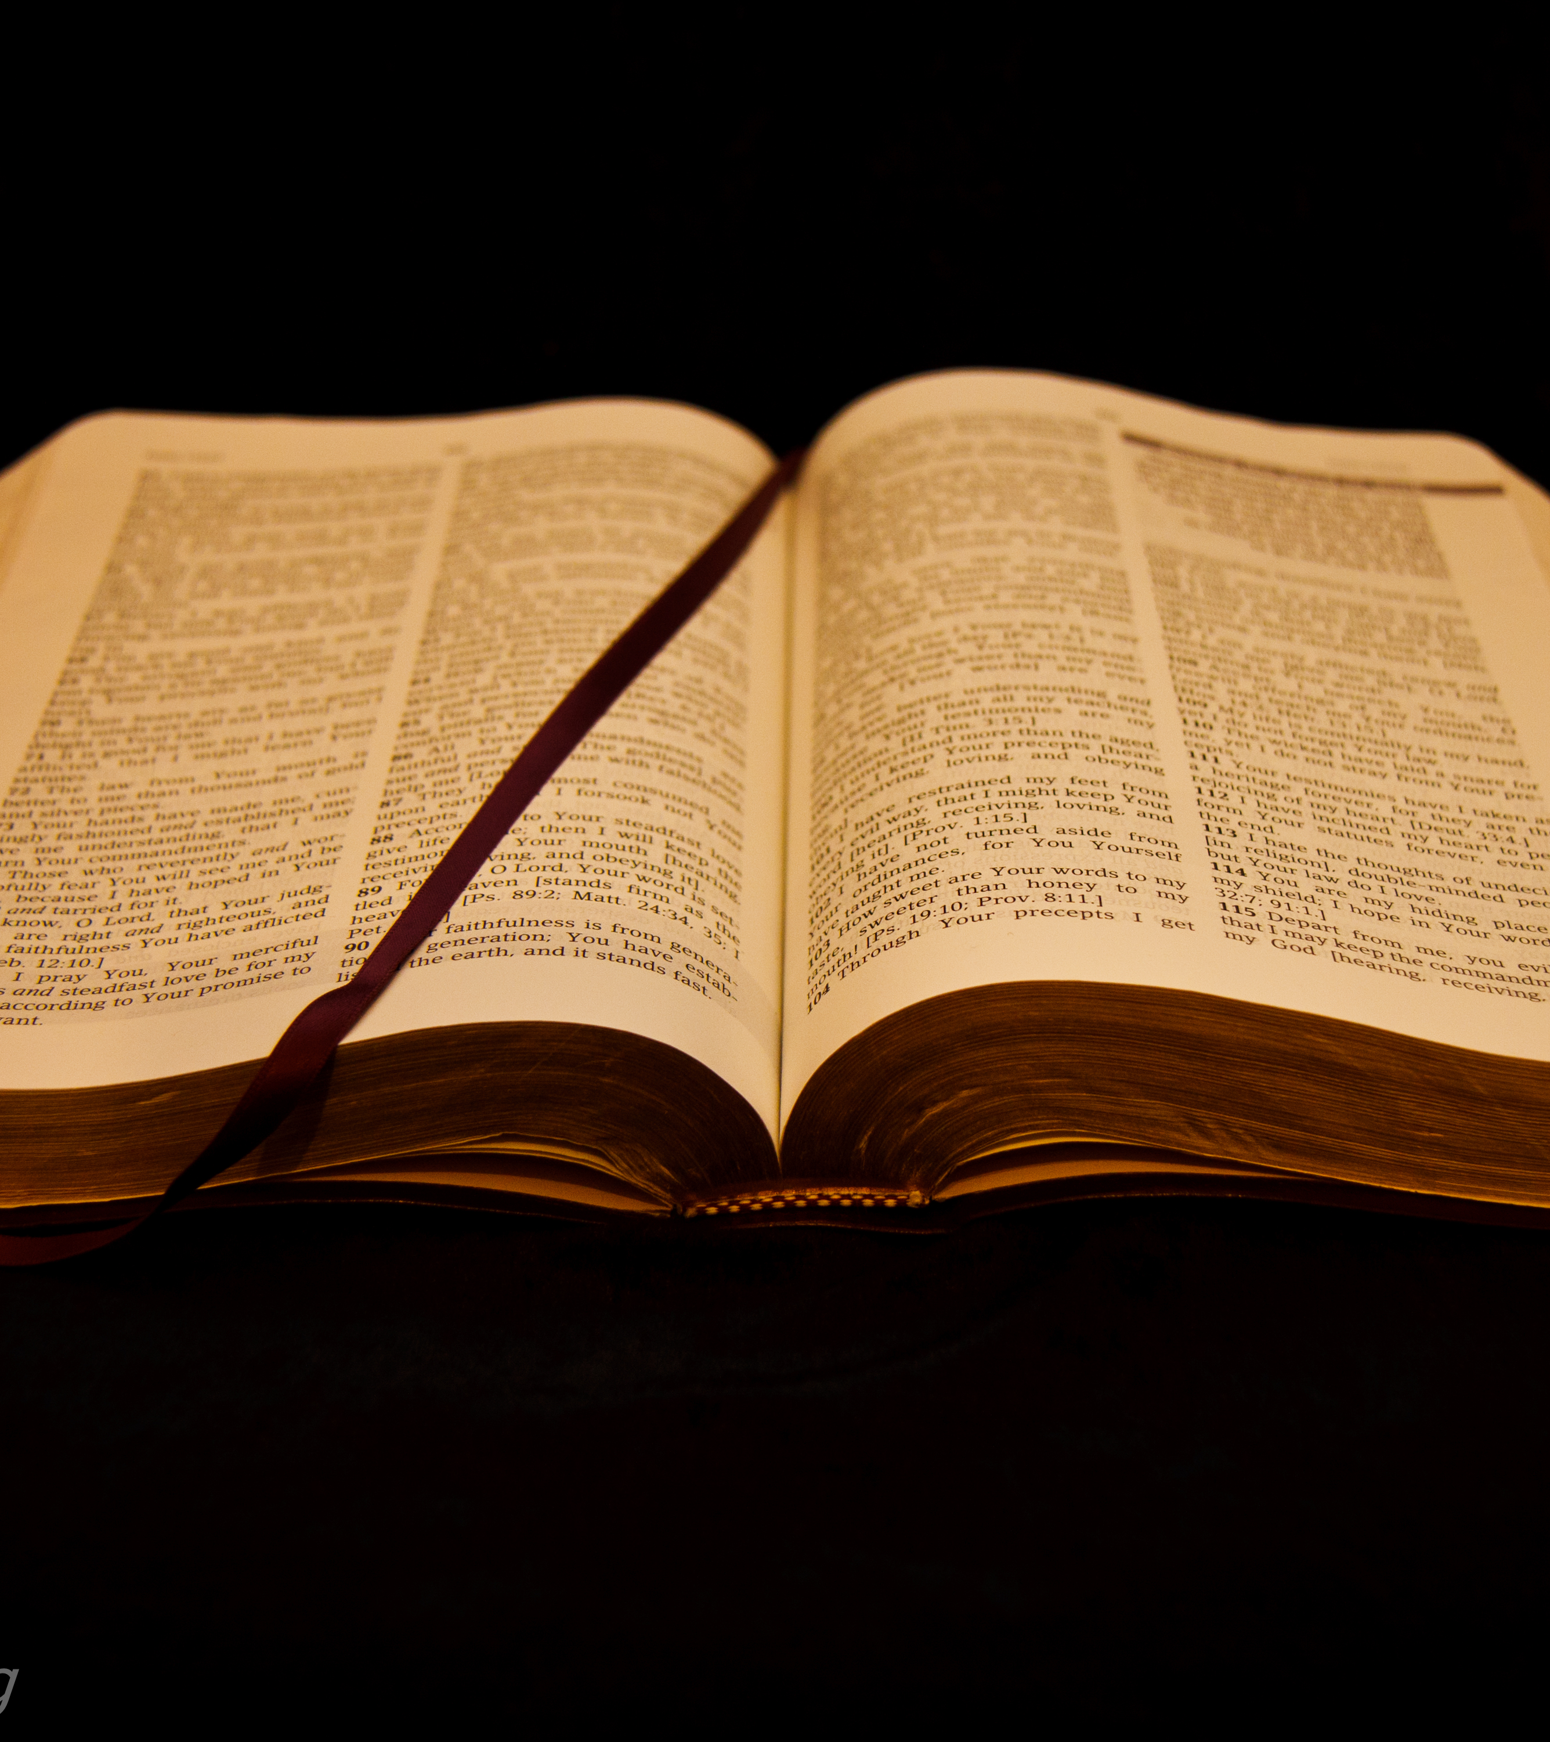
Otherwise it will be impossible for them to exercise the faith which is essential at this time or to occupy the position which God designs them to fill. Every individual has a soul to save or to lose...
This Photo by Unknown author is licensed under CC BY.

Slide 40
Question... (and I've asked it before)...
Do you understand the mediatorial ministry of Jesus (and what he is doing in the real temple now) so that you could explain it to one of these poor deluded confused, and warring souls that we see striving for spiritual and worldly supremacy in our world today?

Slide 41
A more personal & burning Question...
How about for yourself?

Slide 42
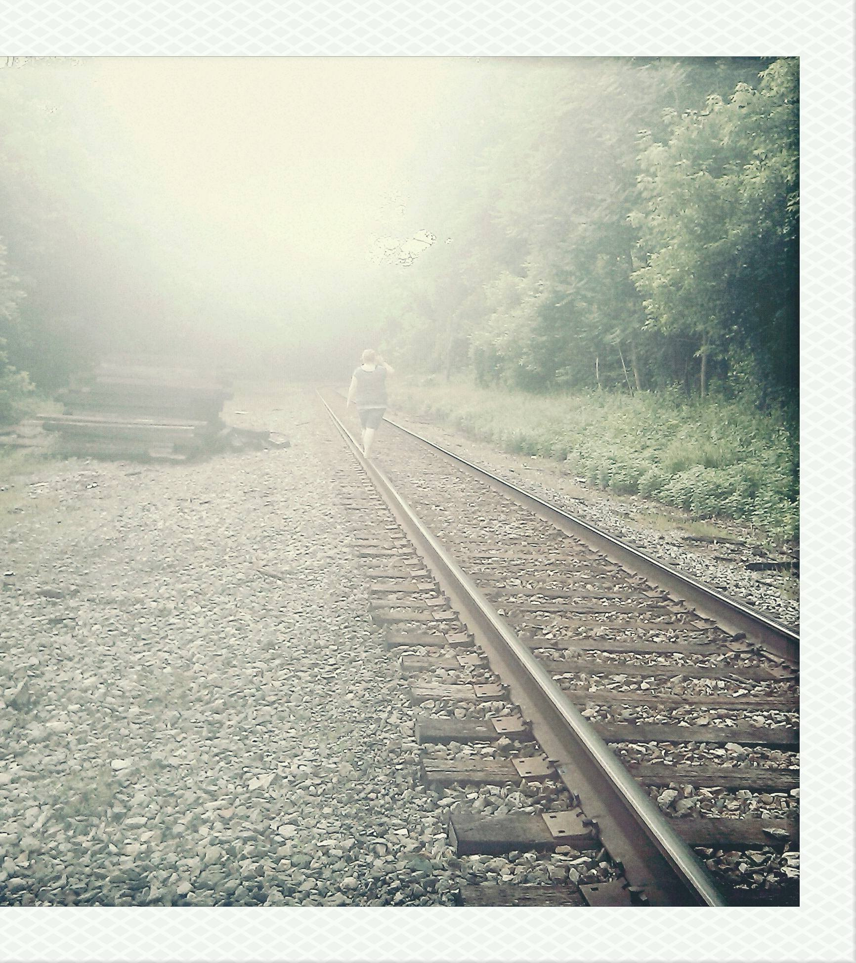
A good place to start...
Hebrews 9:15
And for this cause he is the mediator of the new testament, that by means of death, for the redemption of the transgressions that were under the first testament, they which are called might receive the promise of eternal inheritance.
This Photo by Unknown author is licensed under CC BY-SA.

Slide 43
First things first brothers & sisters...
For what shall it profit a man, if he shall gain the whole world, and lose his own soul?
Mark 8:35

Slide 44
Where is our focus friends?

Slide 45
Time is not growing...
And Jesus answered and said unto her, Martha, Martha, thou art careful and troubled about many things: But one thing is needful: and Mary hath chosen that good part, which shall not be taken away from her.
Luke 10:41,42

Slide 46
We are only Pilgrams here...
This Photo by Unknown author is licensed under CC BY-SA-NC.

