Slide 1
The Everlasting Gospel Part III
The Hope of Glory

Slide 2
Review
Therefore being justified by faith[fulness of Christ], we have peace with God through our Lord Jesus Christ: By whom also we have access by faith into this grace wherein we stand, and rejoice in hope of the glory of God.
Rom 5:1,2

Slide 3
The Dangers of an incomplete presentation of the Gospel
Presumption of peace: “And she shall bring forth a son, and thou shalt call his name JESUS: for he shall save his people from their sins.” Matt 1:21

Slide 4
If we ignore, or have forgotten the spring of the Gospel which is “Amnesty”, we will be trying to make peace with God ourselves, that can not end well. “For they being ignorant of God's righteousness, and going about to establish their own righteousness, have not submitted themselves unto the righteousness of God. “Rom 10:3

Slide 5
End Times Intensification of “Self-righteousness”

Slide 6
How do We Get “There” From Here?
Speaking of the New Jerusalem, the Angel said: “And there shall in no wise enter into it any thing that defileth, neither whatsoever worketh abomination, or maketh a lie: but they which are written in the Lamb's book of life.” Rev 21:27

Slide 7
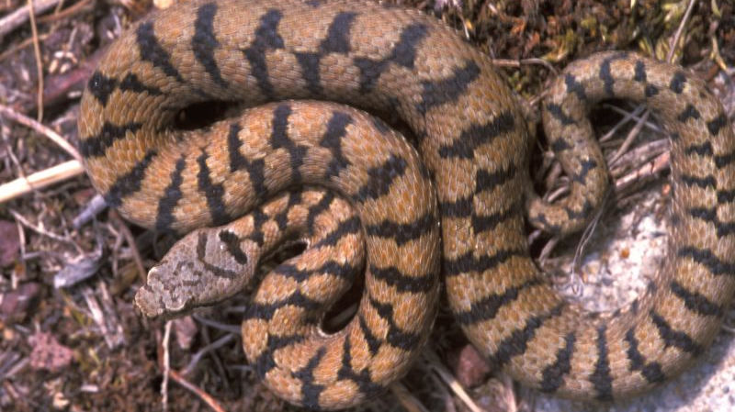
Romans says of all mankind, at the present that; “Their throat is an open sepulchre; with their tongues they have used deceit; the poison of asps is under their lips:”
Rom 3:13
This Photo by Unknown author is licensed under CC BY.

Slide 8
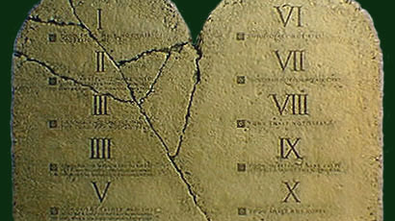
“For ALL have sinned and come short of the Glory of God.
Rom 3:23
This Photo by Unknown author is licensed under CC BY.

Slide 9
The Justified Still Fall Short!
But if, while we seek to be justified by Christ, we ourselves also are found sinners, is therefore Christ the minister of sin? God forbid. For if I build again the things which I destroyed, [Righteousness by Law keeping] I make myself a transgressor. For I through the law am dead to the law, that I might live unto God
Gal 2:17,18

Slide 10
Question:
How are we to enter into that city where nothing sinful will ever enter in, when we still possess our sinful nature we inherited from Adam?

Slide 11
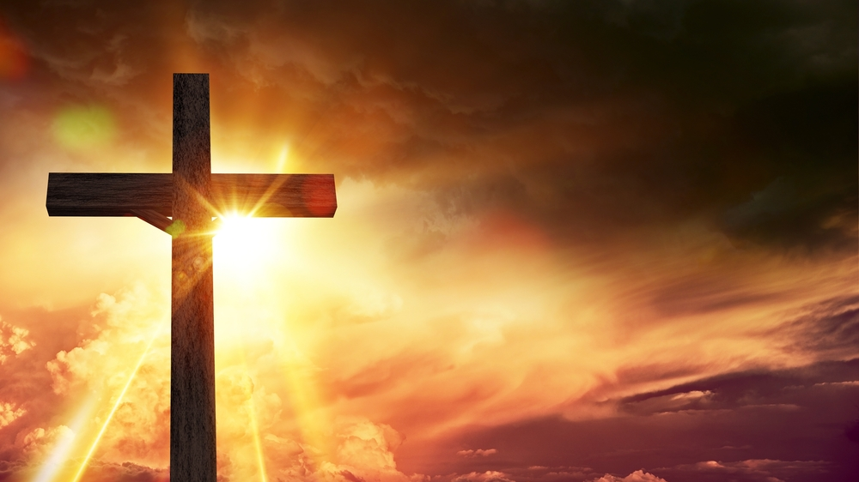
Again, How Do We Get There from Here?
We Must be perfectly cleansed and restored to Holiness!
This Photo by Unknown author is licensed under CC BY.

Slide 12
The Old Covenant
“For the law [The sanctuary service which was an illustration of the plan of salvation] having a shadow of good things to come, and not the very image of the things, can never with those sacrifices which they offered year by year continually make the comers thereunto perfect...

Slide 13
...For then would they not have ceased to be offered? because that the worshippers once purged should have had no more conscience of sins. But in those sacrifices there is a remembrance again made of sins every year. For it is not possible that the blood of bulls and of goats should take away sins.”
Heb 10:1-4

Slide 14
A Better Hope
For the law made nothing perfect, but the bringing in of a better hope did
Heb 7:19

Slide 15
Hope, a biblical Definition
1680 elpís (from elpō, "to anticipate, welcome") – properly, expectation of what is sure (certain); hope. -Helps Word studies
For we are saved by hope: but hope that is seen is not hope: for what a man seeth, why doth he yet hope for? Rom 8:24

Slide 16
Old Covenant & New Covenant Confusion
“Old Covenant was based on works...New Covenant is based on Grace...NO WAY BUDDY! The Law is still binding!!! We need the Law and Grace”….. etc etc… Lots of confusion and wars fought, and all because we have misinterpreted a word!

Slide 17
Covenant
One thing it is definitely NOT, in the context of the “Old and New Covenants, is a contract of reciprocity!!

Slide 18
Covenant, a biblical Definition
For finding fault with them, he saith, Behold, the days come, saith the Lord, when I will make a new covenant with the house of Israel and with the house of Judah:
Heb 8:8

Slide 19
ST1242. diathéké properly, a disposition, i.e. (specially) a contract (especially a devisory will) -- covenant, testament.

Slide 20
Definitions:
Properly: In a strict sense.
Disposition: The act of disposing
Testament: A solemn authentic instrument in writing, by which a person declares his will as to the disposal of his estate and effects after his death. This is otherwise called a will

Slide 21
The roll of Christ’s blood in the establishment of our “Hope” of an inheritance
“For where a testament is, there must also of necessity be the death of the testator. For a testament is of force after men are dead: otherwise it is of no strength at all while the testator liveth” Heb9:16,17

Slide 22
Question:
How important is the New Covenant/Will to the Gospel?

Slide 23
Answer:
Heb 9:22 “With out the shedding of blood there is no remission!

Slide 24
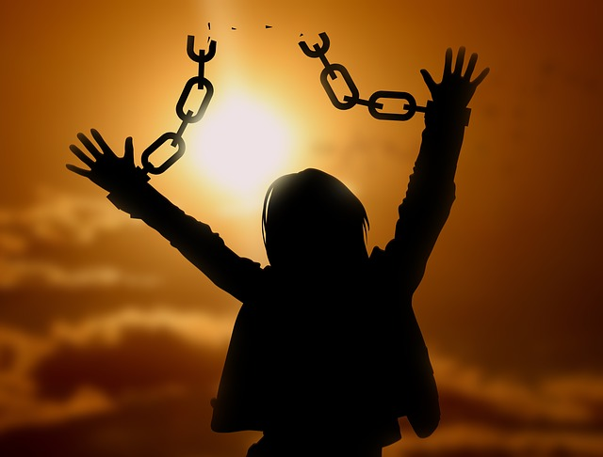
Remision:
ST 859; Release from bondage or imprisonment; freedom.

Slide 25
Every Will and Testament has an Inheritance!
...Now we live with great expectation [Hope], and we have a priceless inheritance—an inheritance that is kept in heaven for you, pure and undefiled, beyond the reach of change and decay. And through your faith, God is protecting you by his power until you receive this salvation, which is ready to be revealed on the last day for all to see.
1Peter 1:3-5

Slide 26
An Inheritance of the Heart & Mind
For this is the covenant that I will make [St. #1303: Dispose of by bequest] with the house of Israel after those days, saith the Lord; I will put my laws into their mind, and write them in their hearts: and I will be to them a God, and they shall be to me a people: Romans 8:10

Slide 27
Question
What is the current prosperity of the hearts and minds of all of mankind?

Slide 28
Answer:
Why should ye be stricken any more? ye will revolt more and more: the whole head is sick, and the whole heart faint. From the sole of the foot even unto the head there is no soundness in it; but wounds, and bruises, and putrifying sores: they have not been closed, neither bound up, neither mollified with ointment. Isa 1:5,6

Slide 29
DEAD
For to be carnally minded is death...I am carnal, sold under sin!
Romans 8:6 & Romans 7:14

Slide 30
Deceitful
The heart is deceitful above all things, and desperately wicked
Jer 17:9

Slide 31
The Law of God
This Photo by Unknown author is licensed under CC BY.

Slide 32
Question
What is this “Law” which God has given to His children as an inheritance?

Slide 33
Answer
The Law of God is a written transcript of what love looks like. It was given so that we might see our true condition and thus flee to Christ for salvation.

Slide 34
“Love worketh no ill to its neighbor therefore love is the fulfilling of the Law.
Rom 13:10

Slide 35
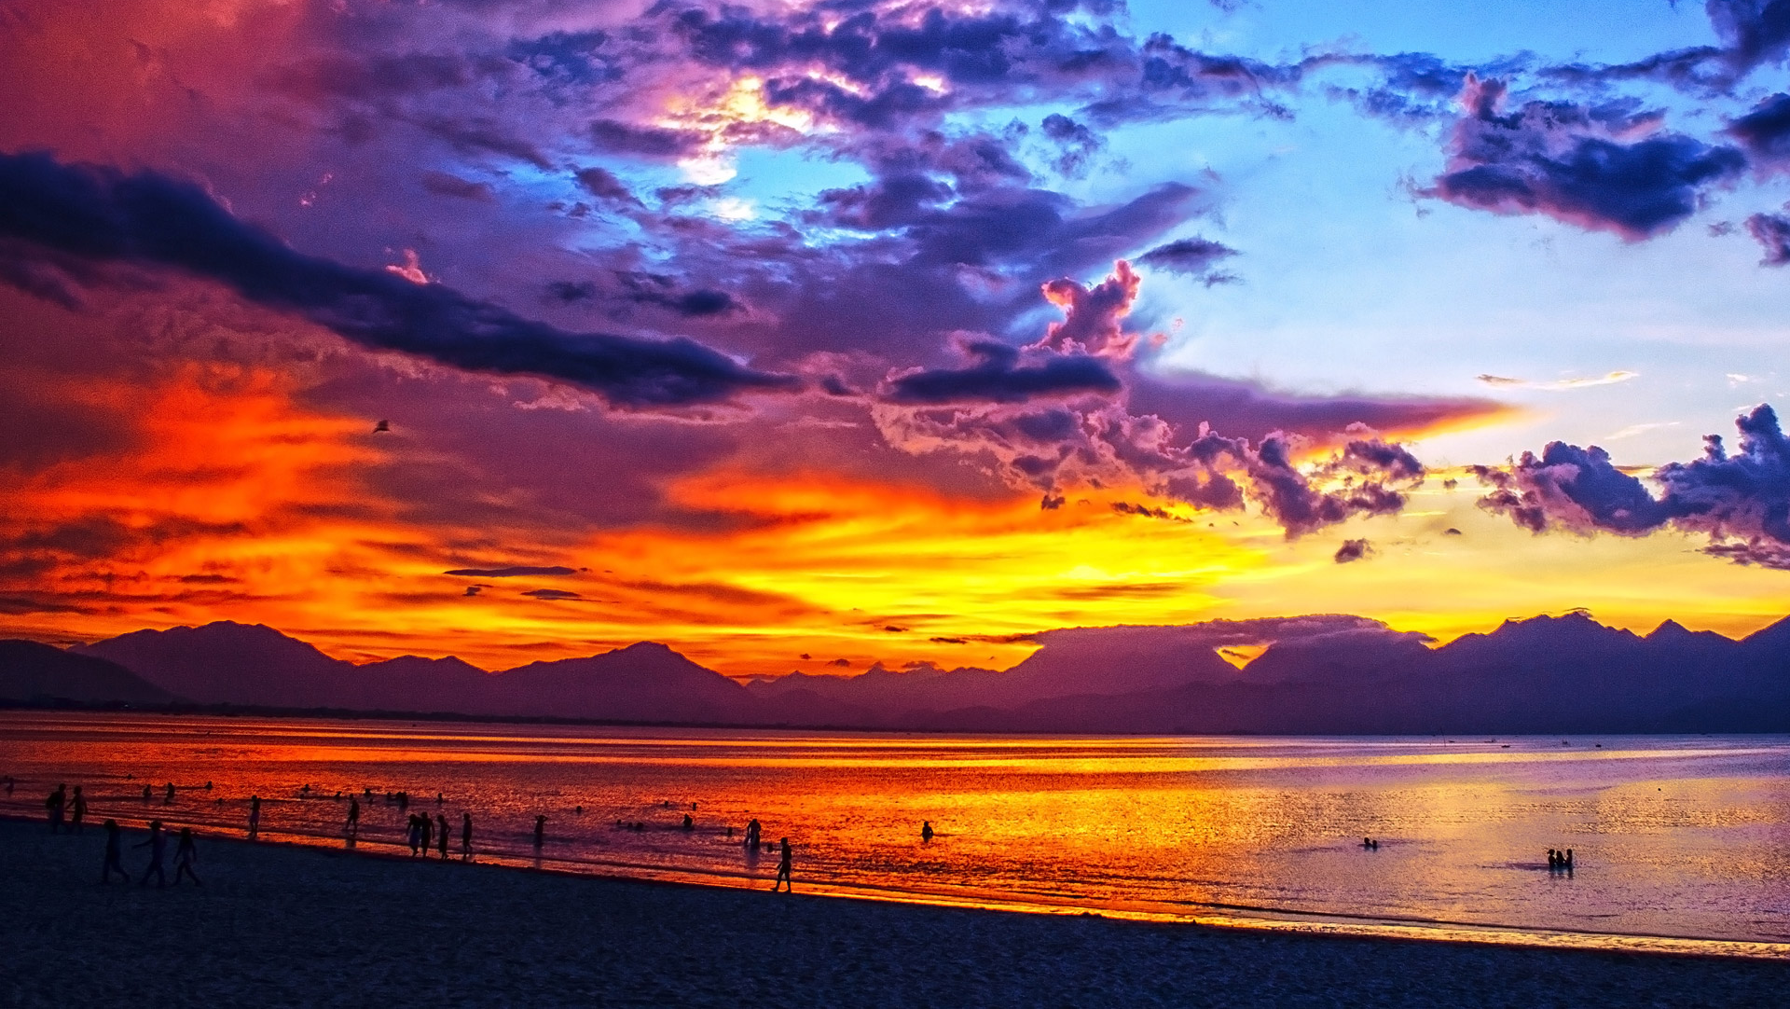
“Wherefore the law is holy, and the commandment holy, and just, and good.” Romans 7:12

Slide 36
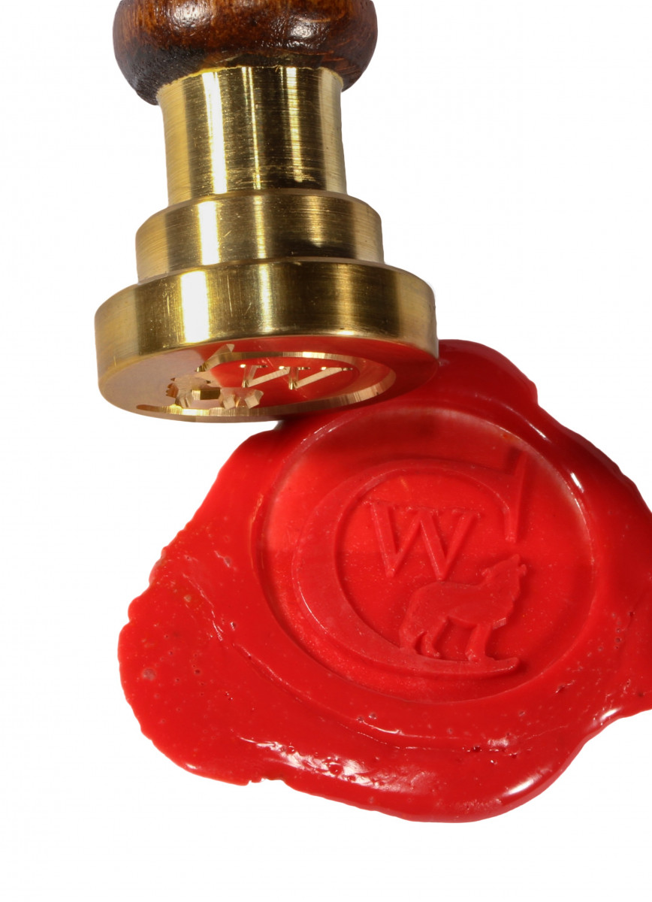
The Inheritance promised to God’s people is His very Holiness/Glory! Put into and sealed into the hearts and minds of His children as an inheritance given to them through Christs’ Will which He signed into force by His death on the cross.

Slide 37
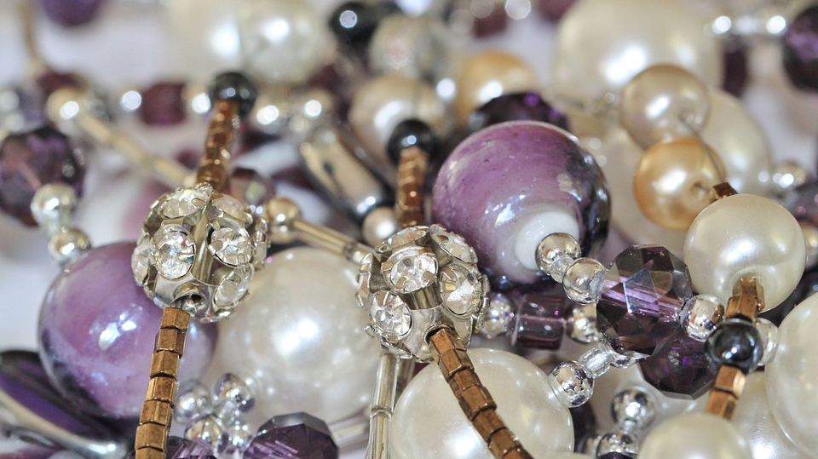
Partakers of the Divine Nature
Whereby are given unto us exceeding great and precious promises: that by these ye might be partakers of the Divine nature, having escaped the corruption that is in the world through lust. 2 Peter 1:4

Slide 38
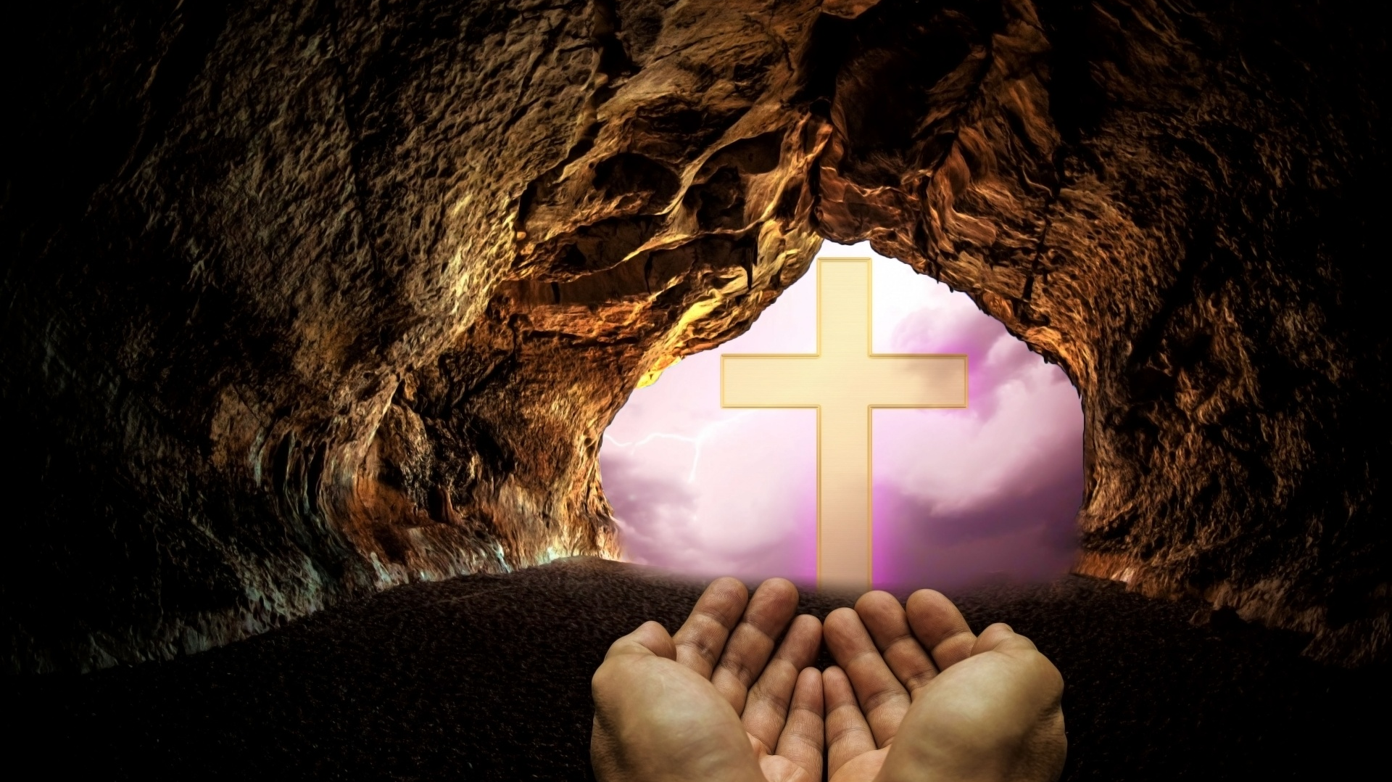
The Blotting out of our sins.
Repent ye therefore, and be converted, that your sins may be blotted out, when the times of refreshing shall come from the presence of the Lord; And he shall send Jesus...
Acts 3:19,20

Slide 39
Remission:
“This is the covenant [Will] that I will make with them [Dispose to them] after those days, saith the Lord, I will put my laws into their hearts, and in their minds will I write them; And their sins and iniquities will I remember no more.
Now where remission [release from bondage] of these is, there is no more offering for sin.” Heb 10:16-18

Slide 40
The Everlasting Gospel

Slide 41
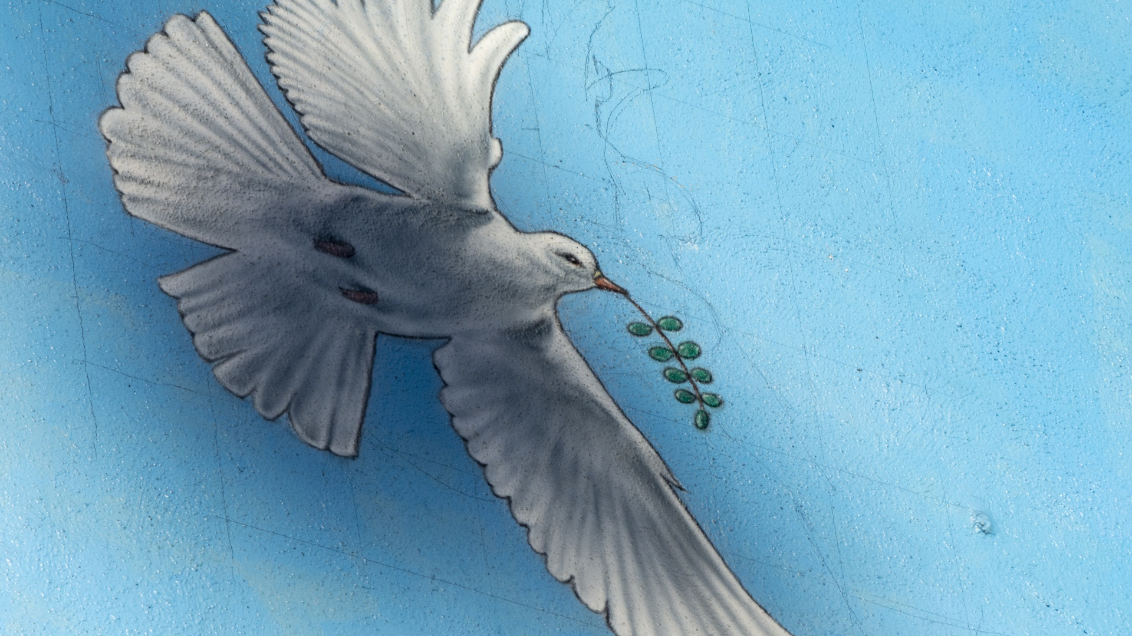
Therefore being justified by faith[fulness of Christ], we have peace with God through our Lord Jesus Christ: By whom also we have access by faith into this grace wherein we stand, and rejoice in hope of the glory of God.
Rom 5:1,2

Slide 42
From Amnesty flows the Grace of life in Christ and to all, who, by the Grace of God are born again by Him as His children, an inheritance of His own perfect nature will be bestowed! This inheritance is what He has promised will fit them to walk in his presence…

Slide 43
“And they shall see his face; and his name shall be in their foreheads”
Rev 22:4
This Photo by Unknown author is licensed under CC BY-NC-ND.

Slide 44
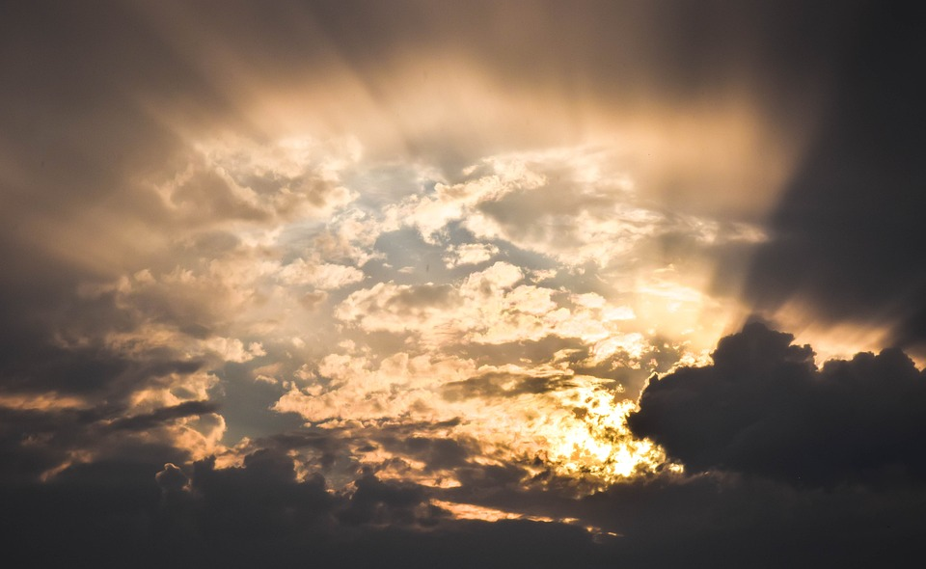
For we through the Spirit wait for the hope of righteousness by faith.
Gal 5:5

